Slide 1
.NET Conf Summary
Slides and images stolen from “real” .NET Conf. presenters

Slide 2
.NET Conf summary

Slide 3
Links
Recording: https://channel9.msdn.com/Events/dotnetConf/2018
Slides: https://github.com/dotnet-presentations/dotnetconf2018/tree/master/Technical/Decks

Slide 4
.NET Conf 2018 Keynote
Scott Hunter, Miguel de Icaza, Mads Torgersen

Slide 5
Video:
https://channel9.msdn.com/Events/dotnetConf/2018/S101

Slide 6
.NET Core 2.1 on TechEmpower
REQUESTS / SECOND
+15%
+18%
+147%
Data sourced from tests on TechEmpower round 16
Notes:
Call out the incredible performance increase in the REAL WORLD data access scenario.

Slide 7
.NET Core 2.1 Major Features
.NET Core
Lazy Loading
Value conversions
Query types
Data seeding
ASP.NET Core
Global Tools
Span<T>
Sockets
HttpClient Performance
Windows Compatibility Pack
EF Core
HTTPS
Razor UI as a library
HttpClientFactory
ASP.NET Core SignalR

Slide 8
.NET Core 2.2 Major Features
.NET Core
Cosmos DB provider
Spatial extensions for SQL Server and SQLite providers
Reverse engineering of database views
Collections of owned entities
Query tagging
ASP.NET Core
Multi-tier JIT compilation
SQL Connection token auth
EF Core
Template updates: Bootstrap 4, Angular 6
Web API improvements, including API security
HTTP/2
IIS in-process hosting
Health checks
Endpoint routing
SignalR Java client

Slide 9
.NET Core 3 Desktop Improvements
.NET Core 3 supports WinForms and WPF frameworks
XAML Islands - WinForms & WPF can host UWP
XAML Controls – WinForms & WPF browser and media UWP controls
High DPI fixes for WinForms
Access to all the Windows 10 API’s
NET Core App Bundler
Precompiled, fast startup
Small apps by removing unused dependencies, link away unused IL
Single self-contained .exe

Slide 10
Keynote - Other topics
Blazor
ML.NET 0.5
Mads Torgersen - C#: Span<T>, nullables
Miguel: Lots of OS contributions to Xamarin (Mono 966 contributor, 35% of the mono code comes from CoreFx and CoreCLR)
Building Mono with VS - goal: easier contribution
Xamarin Android build-time improvements
iOS 12 - Xamarin support
ARKit 2.0 support
Xamarin.Forms Shell

Slide 11
Welcome to .NET Conf 2018! by Jon Galloway, Scott Hanselman
https://channel9.msdn.com/Events/dotnetConf/2018/S102
Lots of community stuff
https://discoverdot.net
https://builtwithdot.net
twitch (Visual Studio channel)
.NET foundation

Slide 12
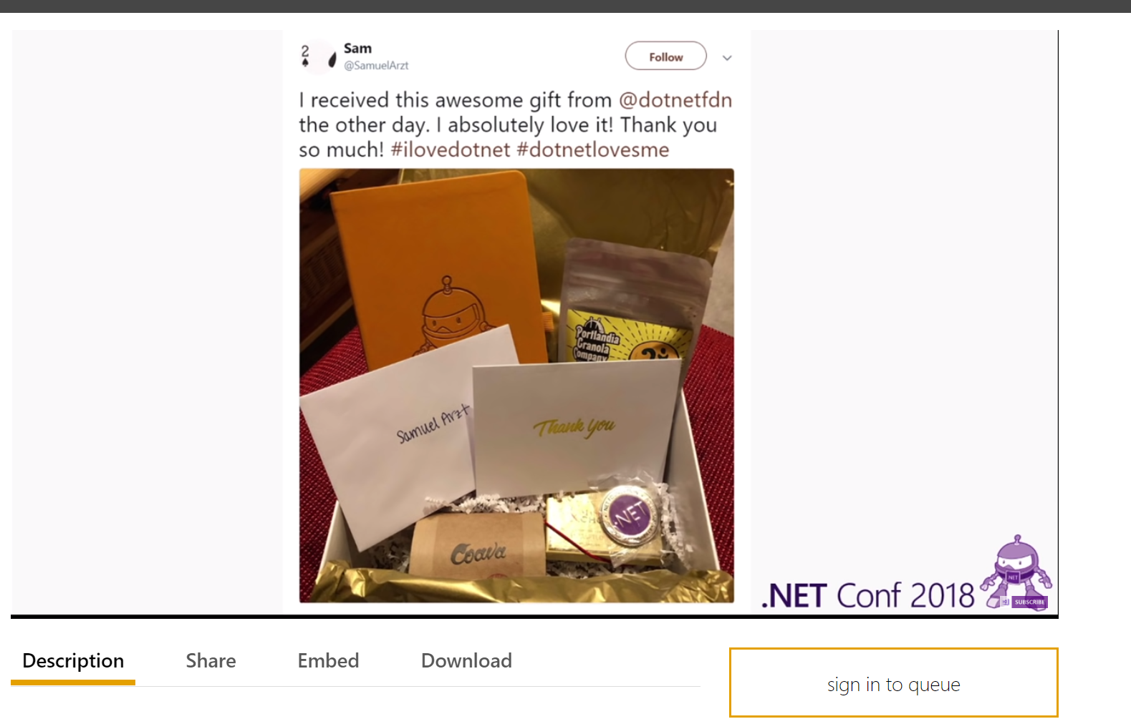
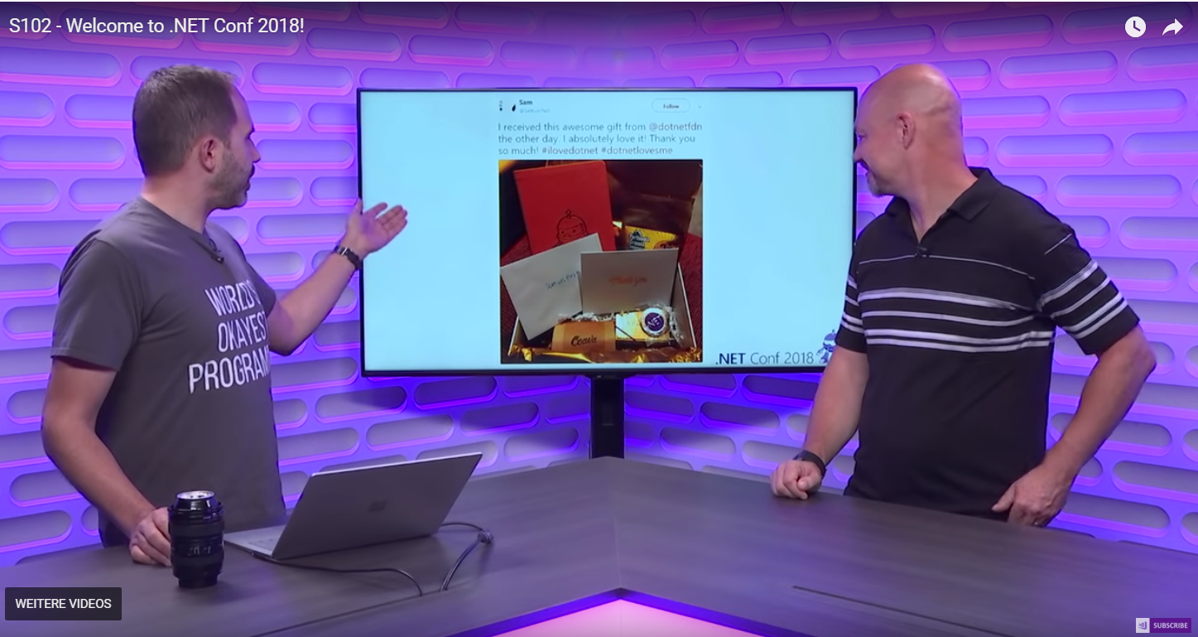

Slide 13
Build Great Libraries using .NET Standard by Immo Landwerth
.NET Standard
2.1 is in planning
Platform specific APIs - Windows Compatibility Pack: a NuGet package that gives you a bunch of windows specific APIs on .NET core
http://aka.ms/apianalyzer
Demo: migrate a .NET Class library (old stuff) to .NET Standard
Demo: targeting multiple frameworks for GPS - net461, uap10.0, netstandard1.4

